Slide 1
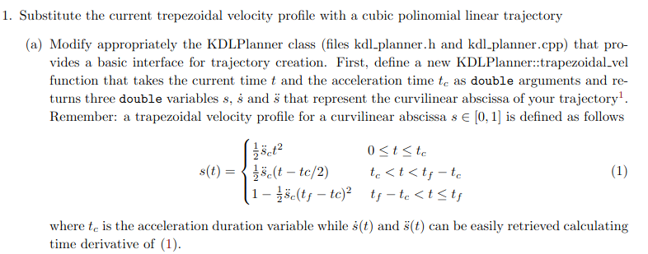
Homework 2
The HM2 consist in working with the KDL library by OROCOS, this library is used for the Kinematics and Dynamics of our manipulators and it’s a more powerful tool respect to only the ros2 control part. The homework starts with the first point in which we have to implement 2 velocity profiles for our 7 DoF IIWA, one is the trapezioidal velocity profile and the other is the cubic polinomial linear trajectory. Then, here is showed the first point and how it’s implemented:

Slide 2
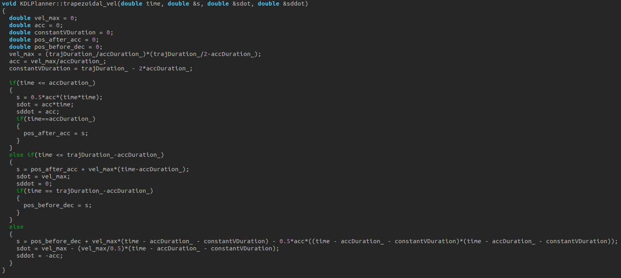
Homework 2
Here I show the implementation of the trapezoidal velocity profile in the KDLPlanner.cpp file, some of the formulas used are slightly different from the ones that have been presented to us, they’re shown in the biggest picture, I’we also used some useful parameters for the maximum velocity or for the partition of the total trajectory time. In the smallest picture there is the declaration of the function in the KDLPlanner.h file:

Slide 3
Homework 2
We can notice that I didn’t follow exactly what the task said, it’s because I tought that in this way it’ll be more efficient and simpler to use, in base of which velocity profile we desire or in function of the trajectory that we want to compute (second point). However, I hope it will be more immediate after I present the rest of the work.

Slide 4
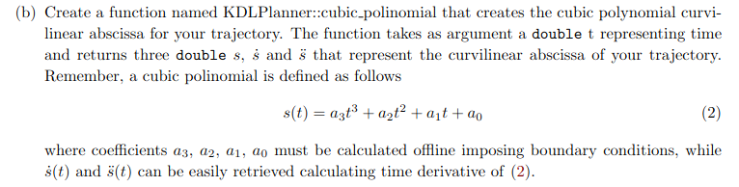
Homework 2
And here it’s shown the request for the other velocity profile that we want and how it’s implemented:

Slide 5
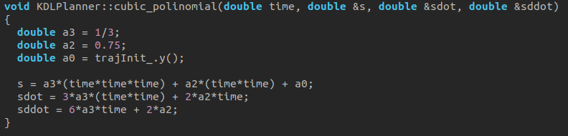
Homework 2
In the upper picture as before, is shown the implementation of the cubic polinomial function and lower there is its declaration in the KDLPlanner.h file:
The choice of the parameter is based on a set of 4 boundary conditions, in this case I used the starting point of the end effector (without the offset), and then I imposed the accelerations at the start and at the end of the trajectory, in a similar way of the trapezoidal velocity profile, and for last I set the initial velocity to zero.

Slide 6
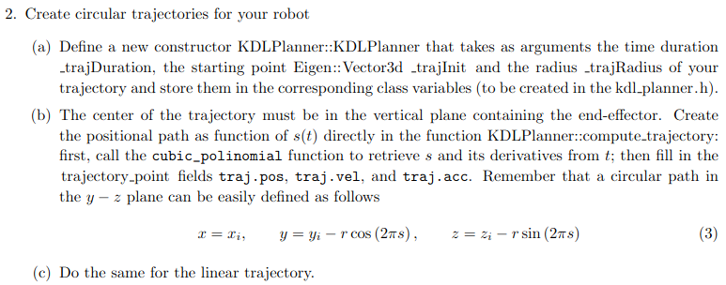
Homework 2
After the implementation of two types of the curvilinear abscissa we need to have a trajectory for it, and in this case there are 2 of them, a circular one and a linear, like specified in the second point of the homework:

Slide 7
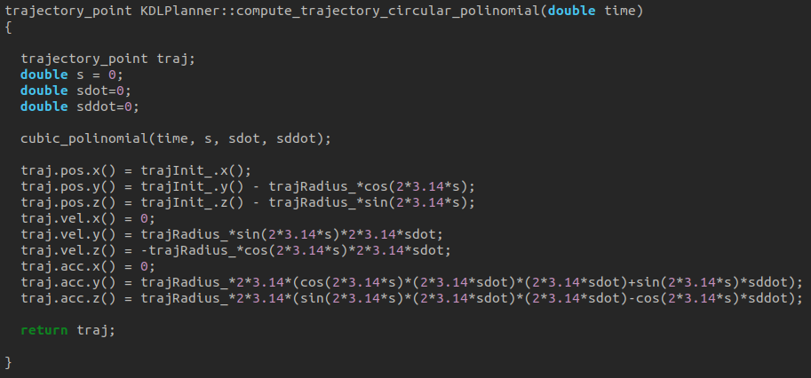
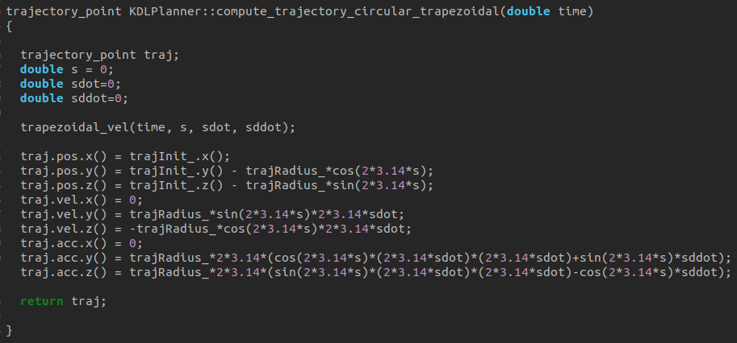
Homework 2
Also in the next point is specified that we need to combine the 2 possible curvilinear abscissa that we have with the 2 trajectories that we need to implement so that we can have 4 possible combinations of the motion for our iiwa. So now that I’ve specified this I’ll show how i decided to implement this to obtain a circular trajectory with a trapezoidal velocity profile or with a cubic polinomial law, we can say the same thing for the linear trajectory:

Slide 8
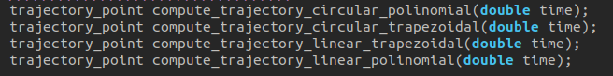
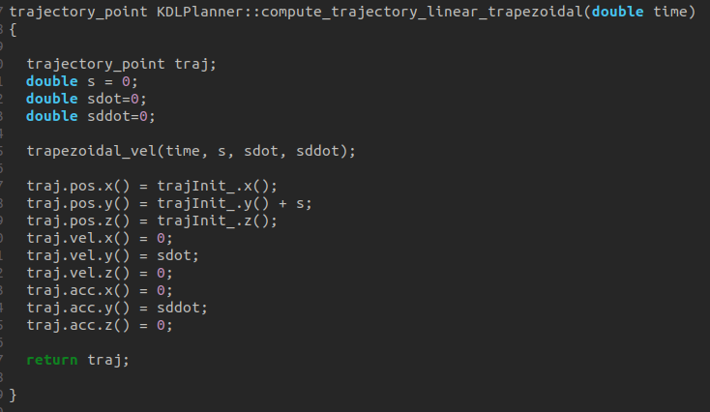
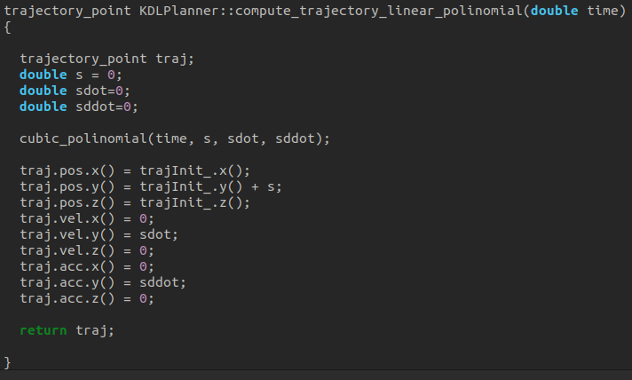
Homework 2
I defined the functions in a different way respect to the requests, because in function of which case we want to use we pass the parameters that we need to the planner and then we ask him to compute te trajectory, which will use only the useful parameters.

Slide 9
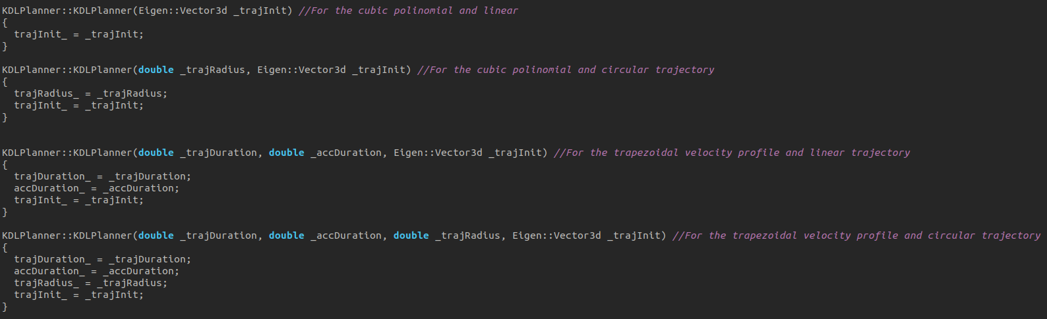
Homework 2
To specify what time law we want for the motion and what trajectory we want we can look at the KDLPlanner.h file and see for every case which are the need parameters, and then pass them inside the ros2_kdl_node. cpp file. Basically it’s something hardcoded, it would fine if the decision and what come after it was implemented by a parameter passed at the launch of the node.

Slide 10
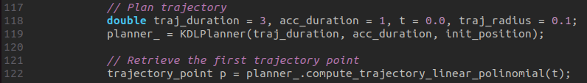
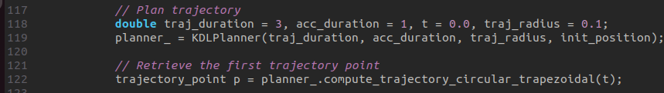
Homework 2
To specify what time law we want for the motion and what trajectory we want we can look at the KDLPlanner.h file and see for every case which are the need parameters, and then pass them inside the ros2_kdl_node. cpp file. Basically it’s something hardcoded, it would fine if the decision and what come after it was implemented by a parameter passed at the launch of the node.

Slide 11
Homework 2
And now I’ll show the results of what I’ve done by some videos of the simulation, however the command interface used for the tests are the position one and the velocity, because I’ve had some trouble and errors trying to use the idContr provided.
I’ve studied the KDLControl files and understood that for the correct execution of the function we need to pass the desired joint quantities, so the positions, velocityies and accelerations, I’ve also noticed that for the first two there aren’t problem because they’re calculated in the position section and velocity section of the kdl_node but also they’re easier to obtain. The trouble I had was with the second order differential kinematics. I tried some solutions to calculate the derivate of the Jacobian manually or using the KDLRobot files but there were always something that I missed. I think the problem consist in the type of the variables that I’ve been using to obtain the J dot and the desider q accelerations.
But however, at least we can see that the robot moves in the desired way so some results are still there.

Slide 12
Homework 2
In the following videos I’ll show the movements of the robot, firstly I used the trapezoidal velocity profile combined with a circular and then a linear trajectory, using the position command interface. Then in the last 2 videos I’ll use the cubic polinomial function and sending commands on the velocity command interface:

Slide 13
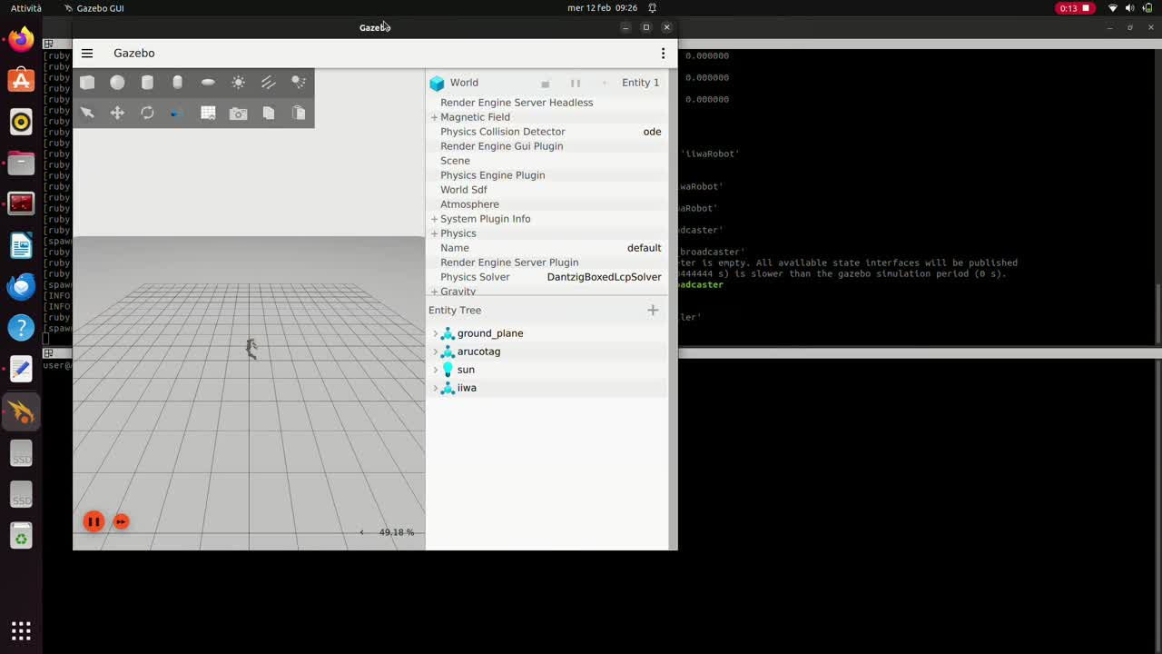

Slide 14
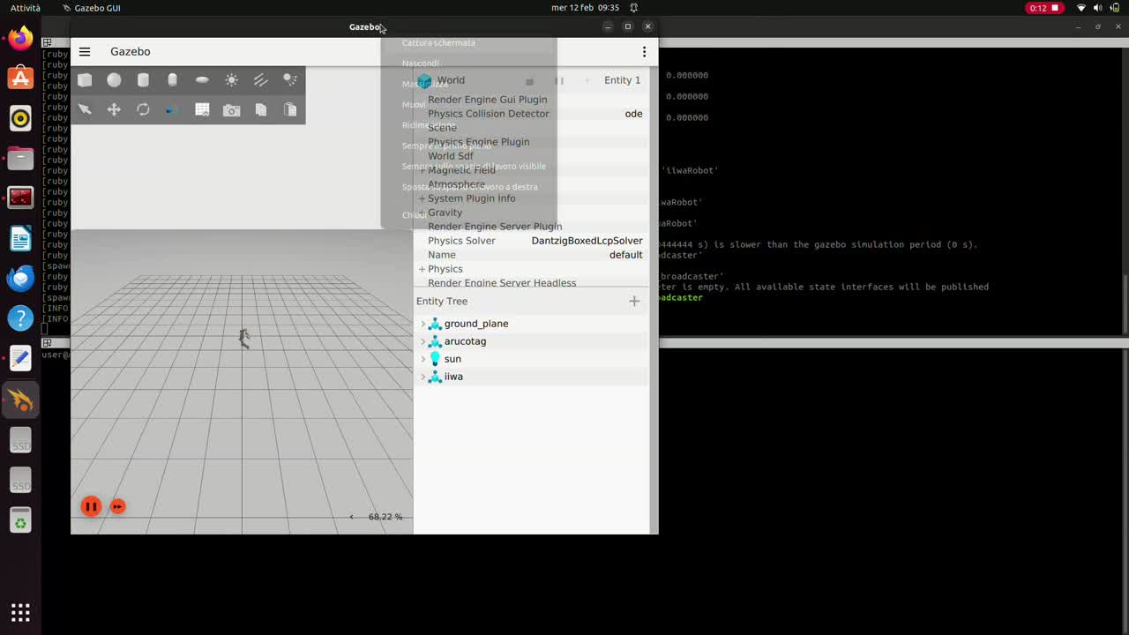

Slide 15
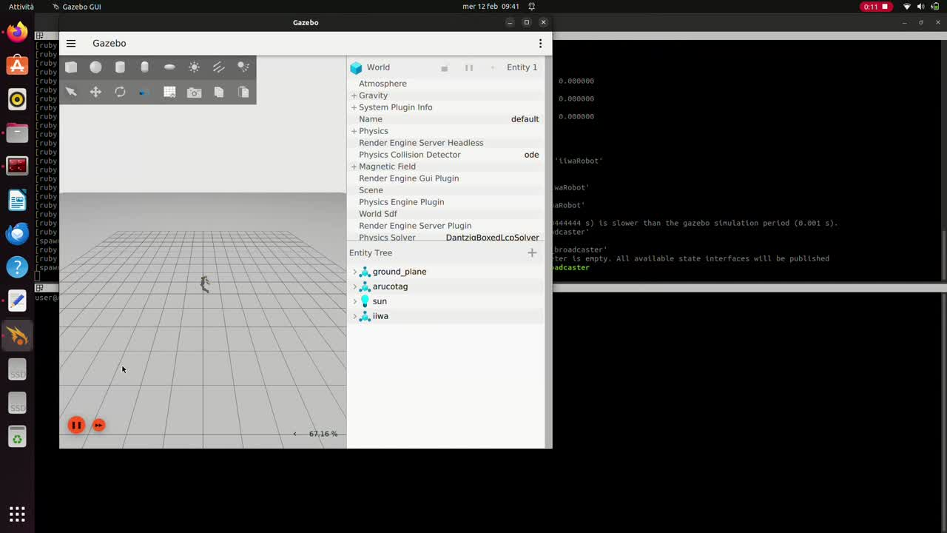

Slide 16
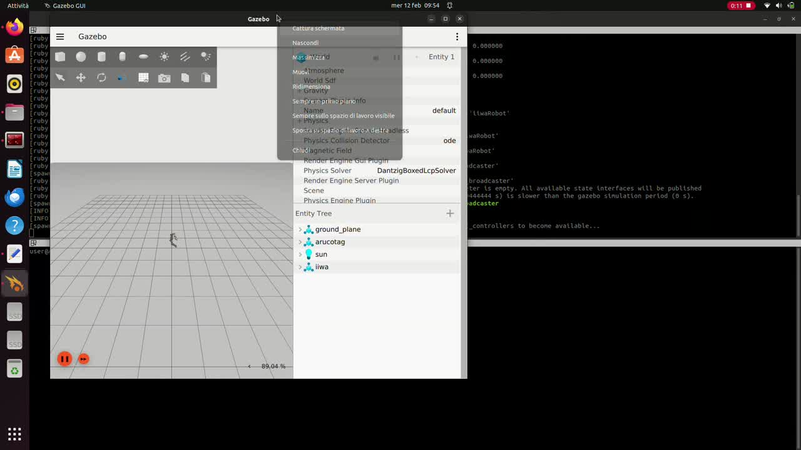

Slide 17
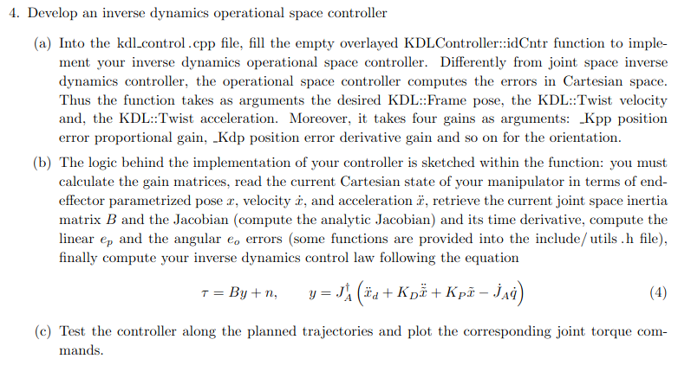
Homework 2
For the last task of this HW we were asked to develop this other ID controller but in the operational space of the robot, in the next slides I’ll show what I’ve did to implement it but unfortunately there’s still some errors in the code so there aren’t tests for this part.

Slide 18
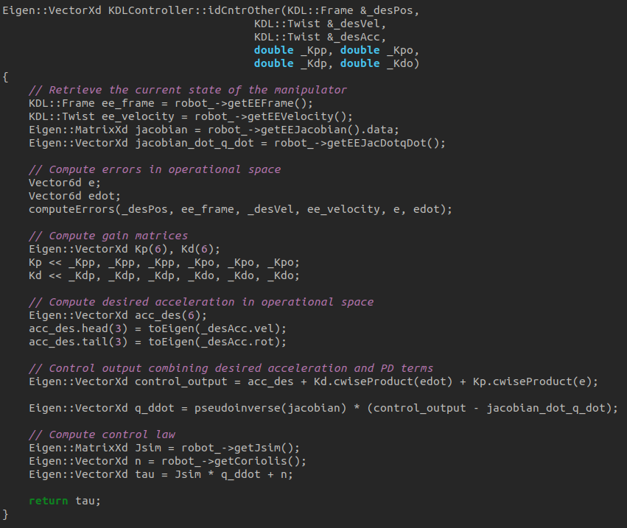
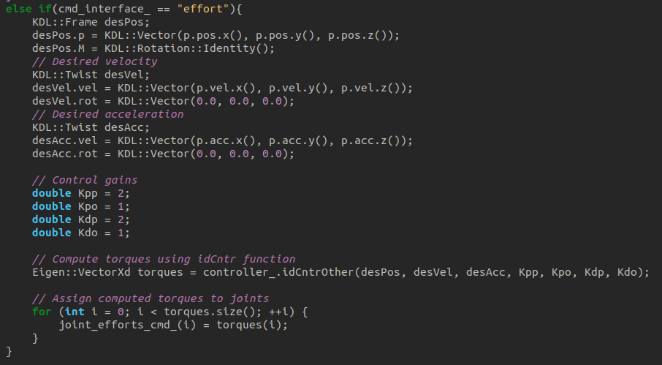
Homework 2
In this last pictures for this homework, the computation of the joint torques is shown in the left picture and then the use of it in the ros2_kdl_node.cpp file in the right picture.

Slide 19
Homework 2
To recap, for starting this simulations and using it are necessary the following packages:
ros2_iiwa;
ros2_kdl_package;
orocos_kinematics_dynamics.
And the commands to launch the simulations are:
for the position control simply: ros2 launch iiwa_bringup iiwa.launch.py use_sim:=true and ros2 run ros2_kdl_package ros2_kdl_node.
If you want to use the velocity command interface, then:
ros2 launch iiwa_bringup iiwa.launch.py command_interface:="velocity" robot_controller:="velocity_controller" use_sim:=true and ros2 run ros2_kdl_package ros2_kdl_node --ros-args -p cmd_interface:=velocity.
Sadly the effort command interface doesn’t work at all, but if you want to visualize the error message that brings up, then:
ros2 launch iiwa_bringup iiwa.launch.py command_interface:="effort" robot_controller:="effort_controller" use_sim:=true and ros2 run ros2_kdl_package ros2_kdl_node --ros-args -p cmd_interface:=effort.

Slide 20
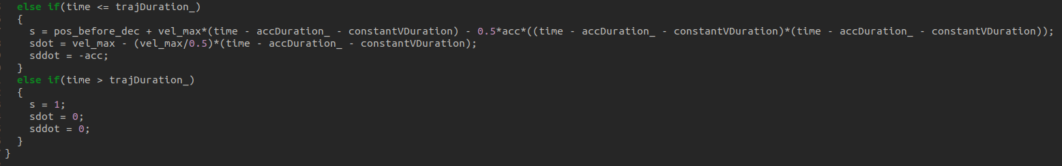
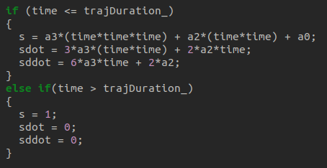
Homework 2
But, with this project isn’t finished yet. After the first version I wanted to work a little bit longer on it to try some better implementation of the ros2 kdl note. The first change that comes in my mind is that for example in the KDLPanner.cpp file I apported some modifications to be certain that after the finish of the trajectory, the manipulator will remain in the last configuration without doing some other not expected movements. This is done in the sequent way:

Slide 21
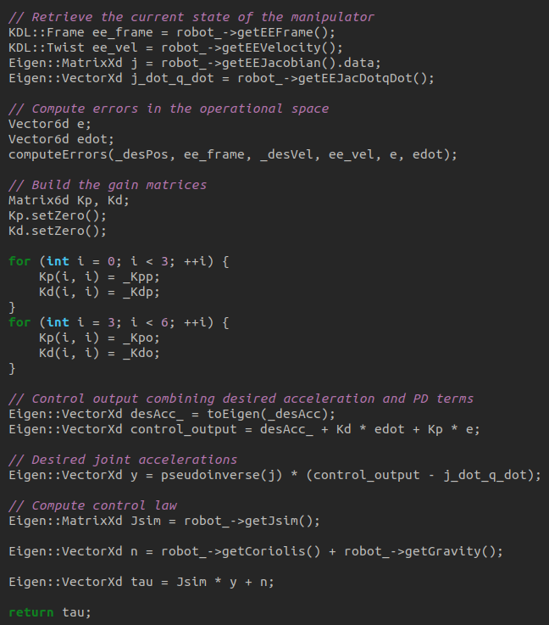
Homework 2
Some little modification were also done in the function to calculate the inverse dynamics control in the operational space but there’s still some missing things unfortunately.

Slide 22
Homework 2
The biggest changes were done in the ros2 node code. One thing that doesn’t work fine in the previous version was the choice of the trajectory or of the definition of the curvilinear absissa. Basically there was the need to colcon build every time that you wanted to change the definition of the robot’s movement. So I decided to introduce some other launch parameters, like the trajectory choice or the abscissa type. But nothing’s perfect, neither this thing, because I’ve noticed that you can correctly pass only one parameter of your choice, if you try to pass multiple parameters it won’t work.
The idea sounds nice because if it would work properly, the code begins more dynamic, so that the parameters passed to the KDLPlanner and also the trajectory calculation is done in function of the passed parameters.
In the next slide I’ll show how I’ve implemented this idea:

Slide 23
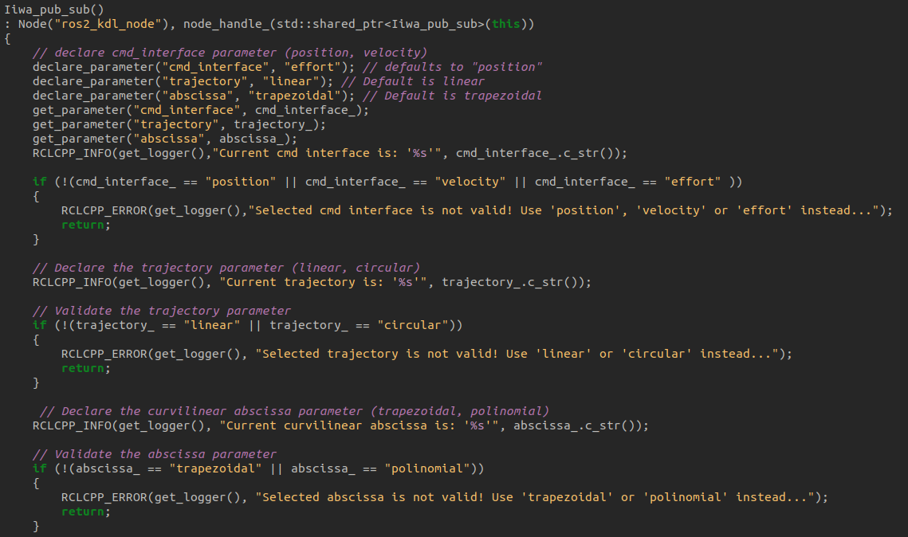
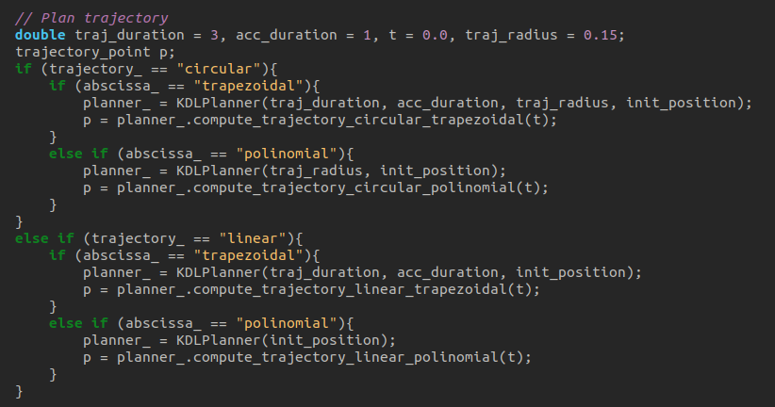
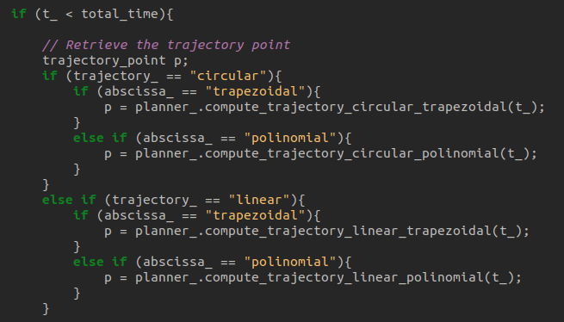

Slide 24
Homework 2
Some other modifications were also done for the part of the simulation that follows the end of the trajectory execution. In practice, if the command interface is the velocity one, basically I send the velocity commands to the joints equal to zero. If instead the robot is controlled by effort, to avoid the manipulator to fall down due to gravity after the trajectory is executed, I use again the idContr function to calculate the desired efforts for the joints, but the goal this time is for the robot to stay in the last configuration that he had when the trajectory has come to the end.
This code is shown in the next slide:

Slide 25
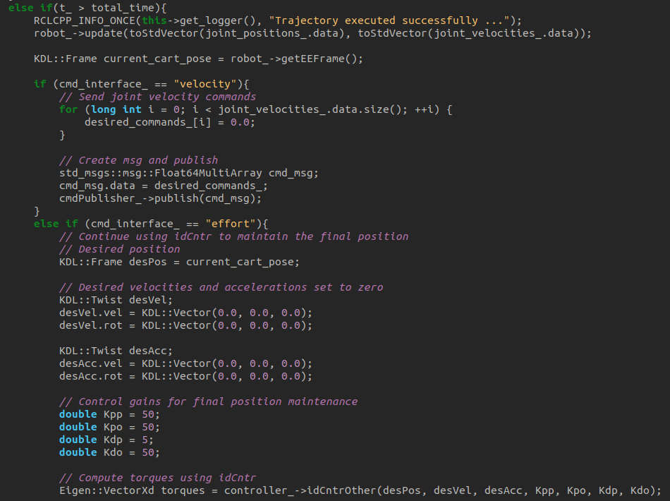
Homework 2

Slide 26
Homework 2
This new code of the ros2_kdl_package can be seen in my github page, HW2 repository, but not in the main branch, in the other one. If you wanna try something with it then I’ll remember you the launch parameters.
For the cmd_interface:
position (set by default)
velocity
effort
For the trajectory:
linear
circular
And for the definition of the abscissa:
trapezoidal
polinomial
If you wanna use the code more dynamically you can specify what values you want set to default, but it would be better if it worked directly passing all the needed parameters.
Thanks for the attention, and to the next HM ;)

